Slide 1

Simple SIMD Processor.
EEE 4232 – VLSI II Project
Group 4
Tanvir Hoque - 180205041
Avishek Debnath - 180205014
Akfa Sultana Mithika - 180205005

Slide 2
01
INTRODUCTION
02
DESIGN OF ALU
TABLE OF CONTENTS
03
SYNTHESIS
04
PNR AND VERIFICATION
05
CONCLUSION & FUTURE OUTCOMES

Slide 3
INTRODUCTION
SIMD stands for Single Instruction Multiple Data. It is a type of parallel processing technology used in computer architectures to perform the same operation on multiple data elements in parallel. SIMD instructions allow a CPU to process multiple data elements in parallel within a single instruction cycle, increasing the overall performance and efficiency of the system.
SIMD technology is widely used in applications such as image and video processing, scientific simulations, and cryptography, where large amounts of data need to be processed in parallel. Many modern CPUs, including those based on the x86 architecture, support SIMD instruction sets, such as SSE and AVX.
This project is to implement a simple SIMD processor, core of which is a 16-bit SIMD ALU. 2's compliment calculations are implemented in this ALU. The ALU consists of three SIMD basic computation units: SIMD adder, SIMD multiplier and SIMD shifter.

Slide 4
SIMD ADDER
SIMD MULTIPLIER
DESIGN OF ALU
SIMD SHIFTER
The SIMD adder is implemented based on 4 4-bit adders. To reuse the adder for data with different width, the input signals, H, O and Q, control the forwarding of the carries between the adders.
The SIMD multiplier is implemented with adders and shifters. To make it support multiplication with different data width, the input signal, H, O and Q, are used to control the input operands of the adders and select corresponding outputs for the target data width.
The SIMD shifter can also support data with different width. It is based on two 16-bit shifters and necessary overstep-correct logic.

Slide 5
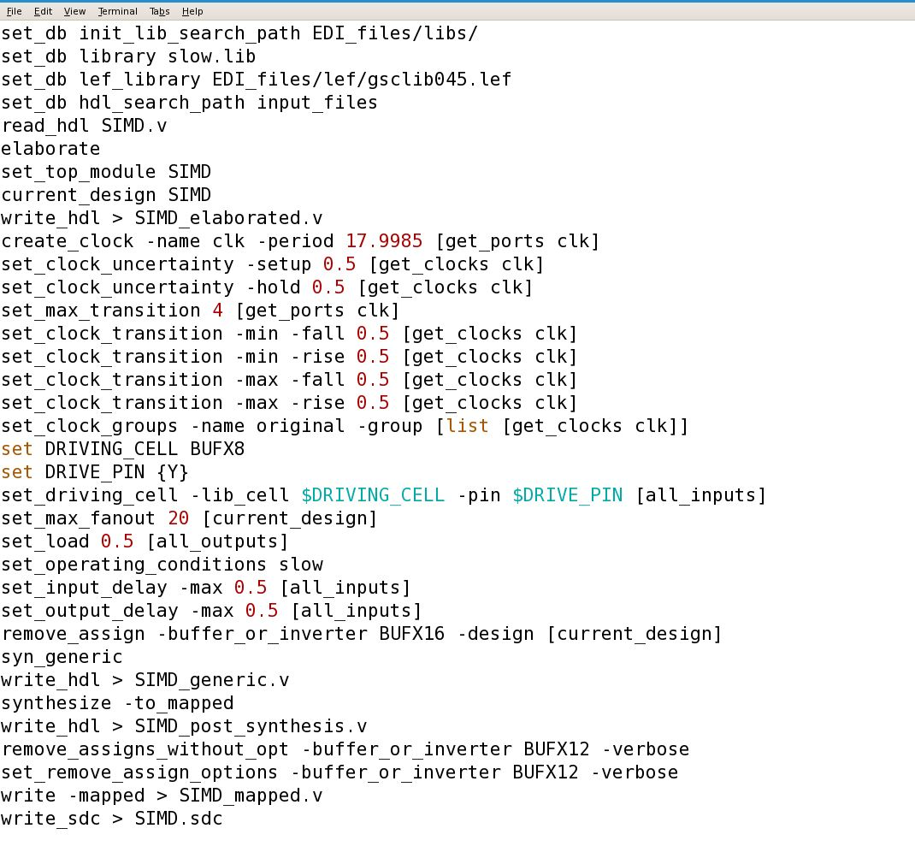
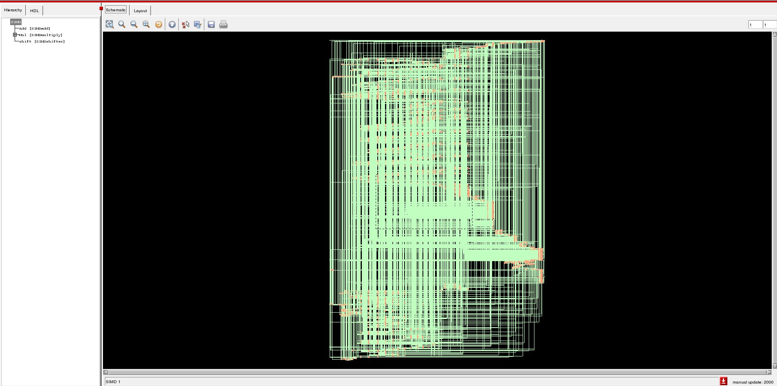
SYNTHESIS
Fig2: Schematic view
Total No. of gates | 2885
Dynamic Power | 313.707 nW
Leakage Power | 1383115.097 nW
Fig1: Constraint tables

Slide 6
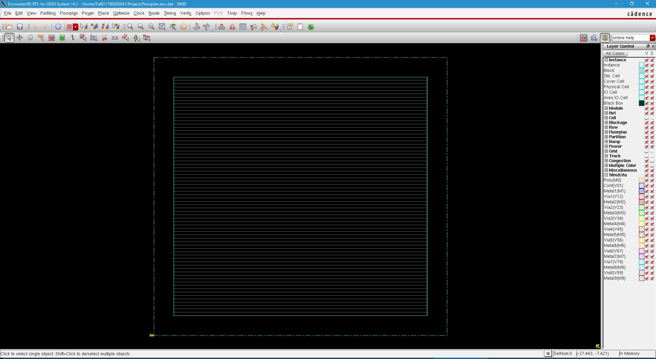
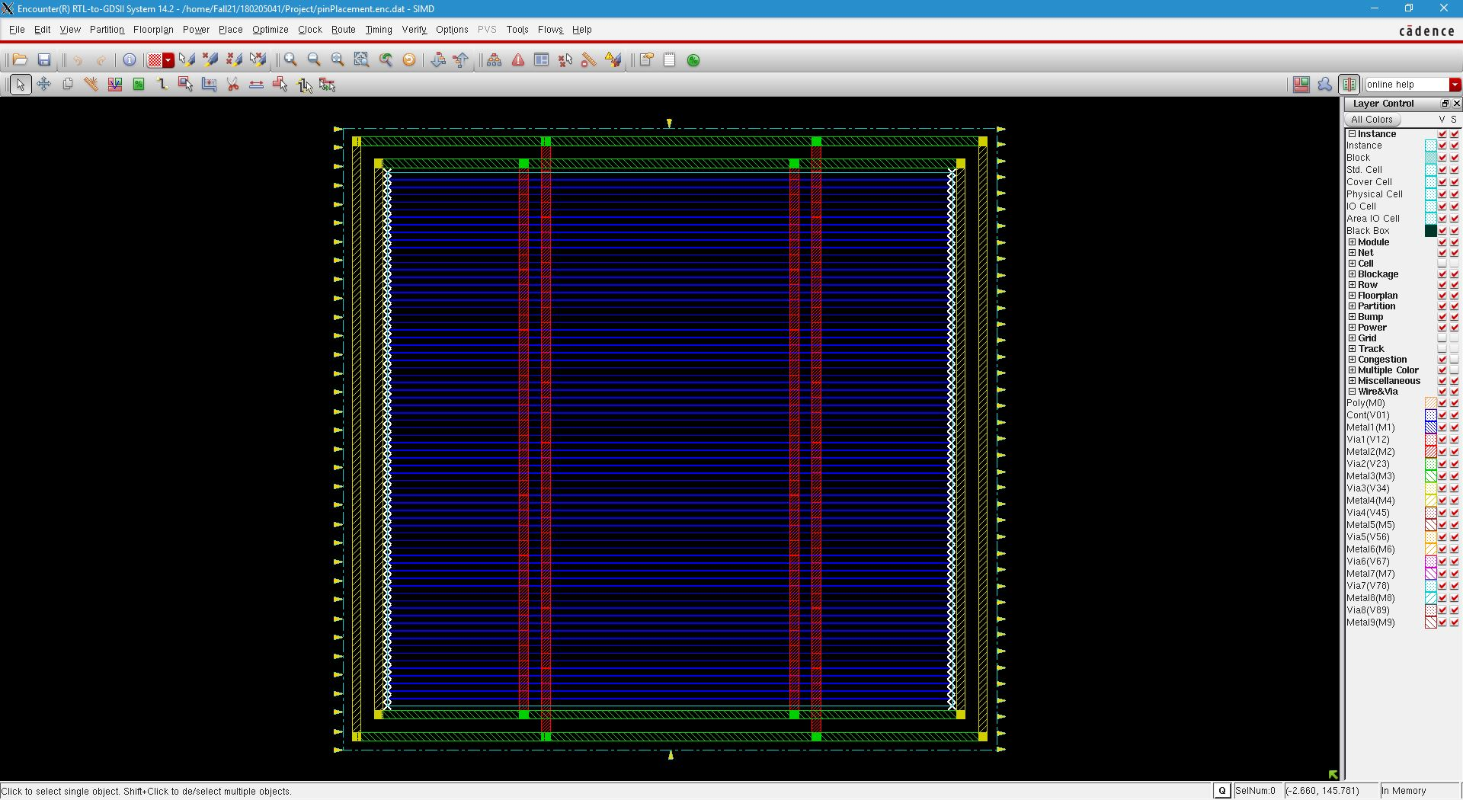

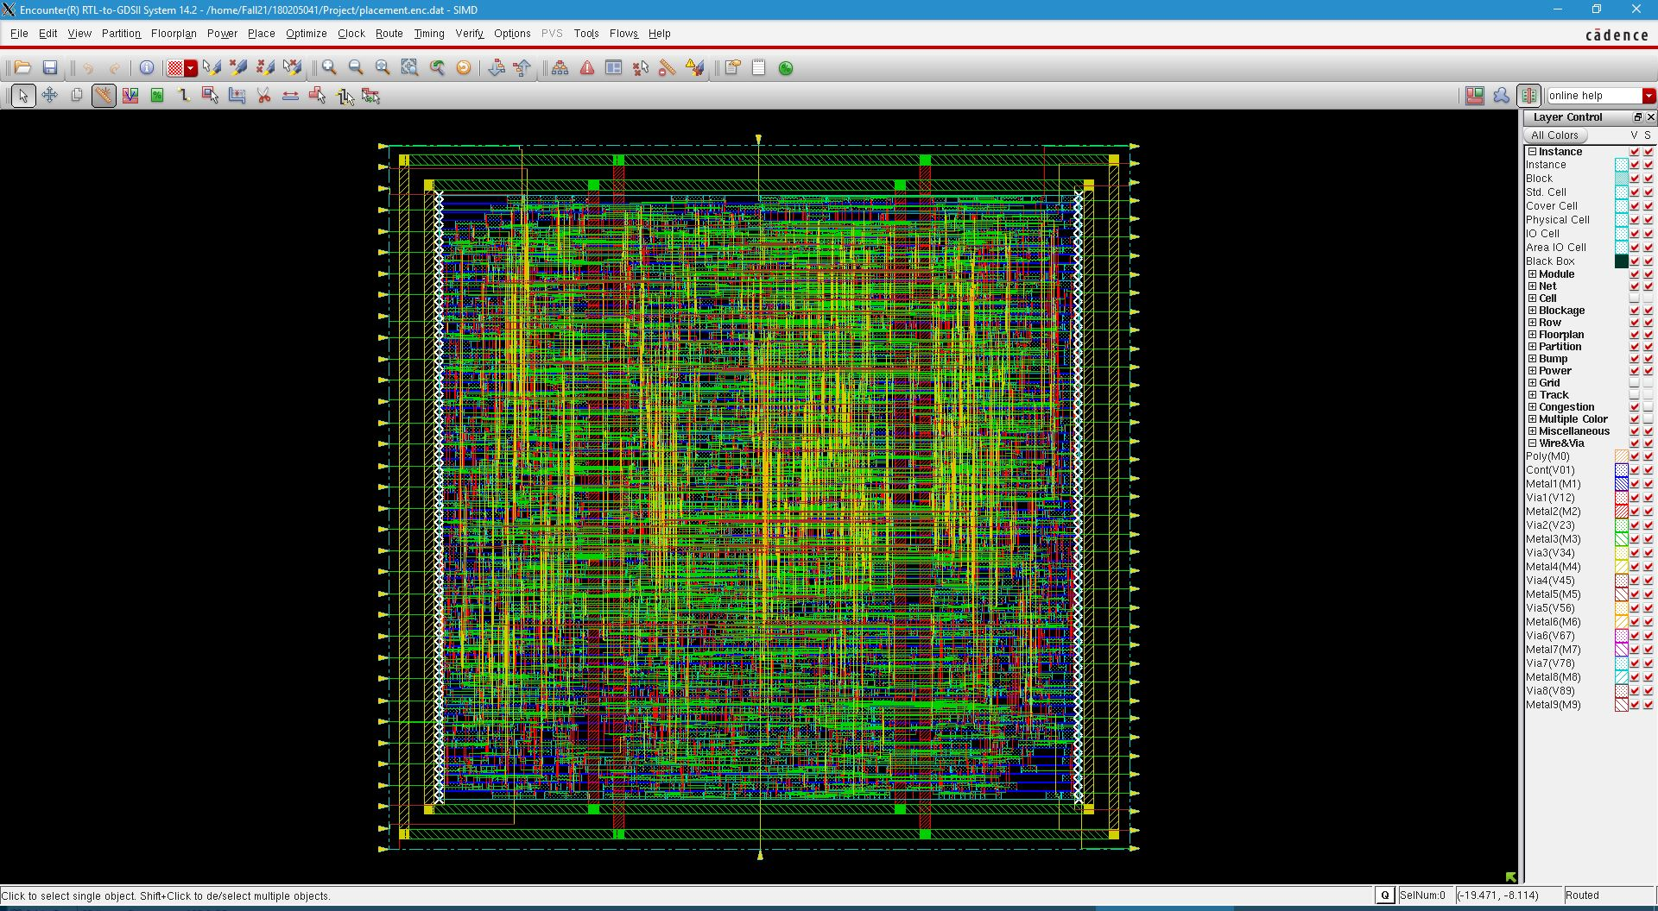
PNR
Fig: Floorplan
Fig: Pin Placement
Fig: PowerPlan
Fig: Placement

Slide 7
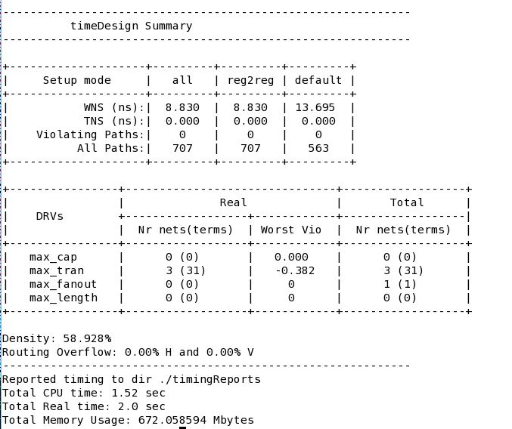
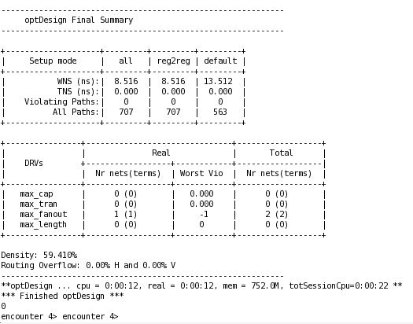
PNR
Static Time Analysis
Fig1
Fig2
Fig1 is the summary of existing setup and DRV violations in the pre-CTS stage. In the summary report, there is a negative value in max_tran which indicates that there is a violation.
So, to solve this violation optDesign –preCTS command is used in encounter terminal for optimization.Optimized summary reports is in fig2.

Slide 8
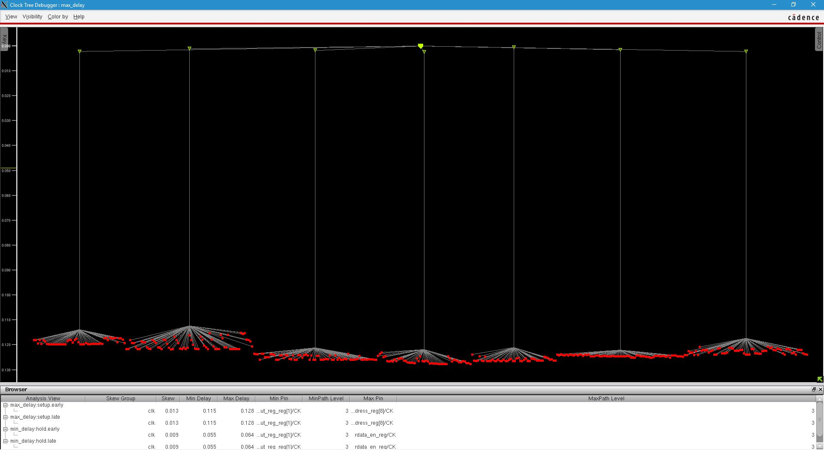
PNR
Clock Tree Synthesis
After optimizing the design in placement stage, clock tree is needed to built in the design for balancing clock skew and latency. It is built using a clock buffer or inverter cells.

Slide 9
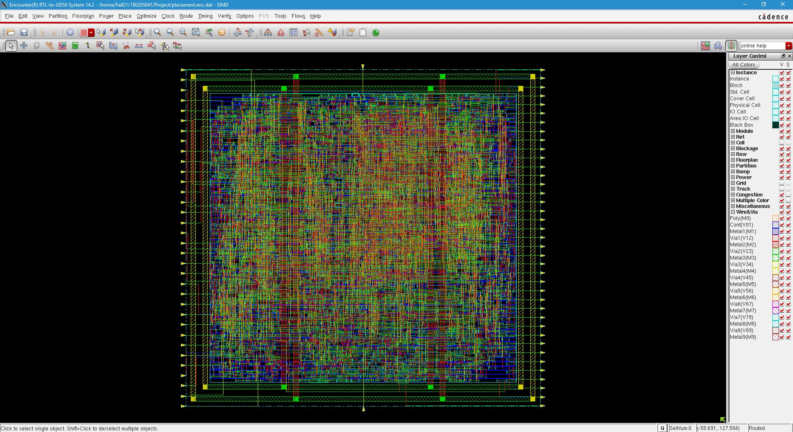
PNR
Routing
Pre-CTS optimization is done in placement stage and after then we built the clock tree in CTS stage.Now, we need to perform detailed routing.

Slide 10
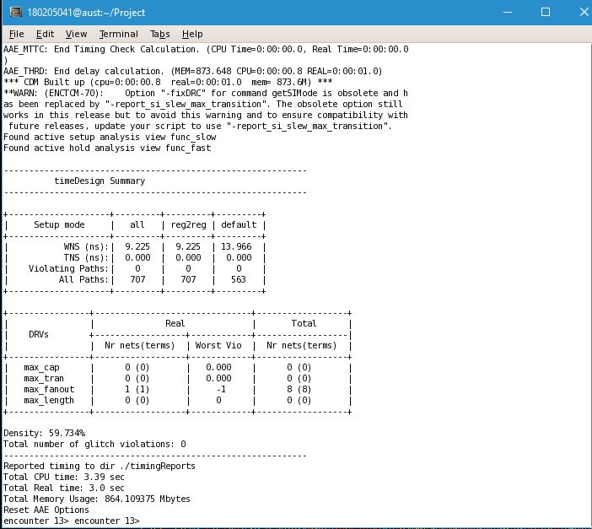
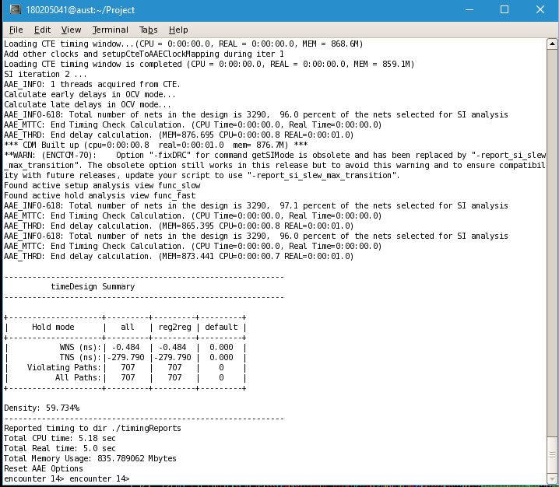
PNR
Post-Route Timing Optimization
Summary of existing setup and DRV violations
Summary of Hold violation
Previously, we check the summary report of existing setup and DRV violation on pre-CTS stage, now we will check it for routing stage.

Slide 11
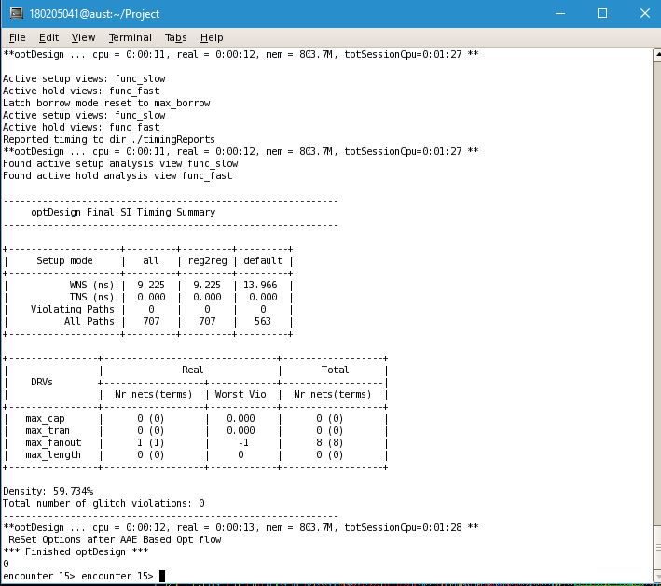
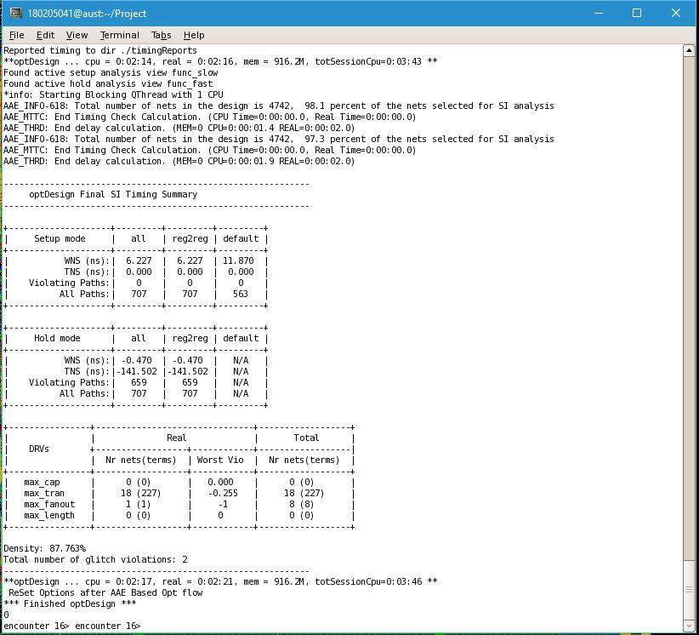
PNR
Post-Route Timing Optimization
fig1
fig2
We tried to clean existing setup and DRV violations in post-route stage which summary report is in fig1 and also tried to clean hold violation which summary report is in fig2.

Slide 12
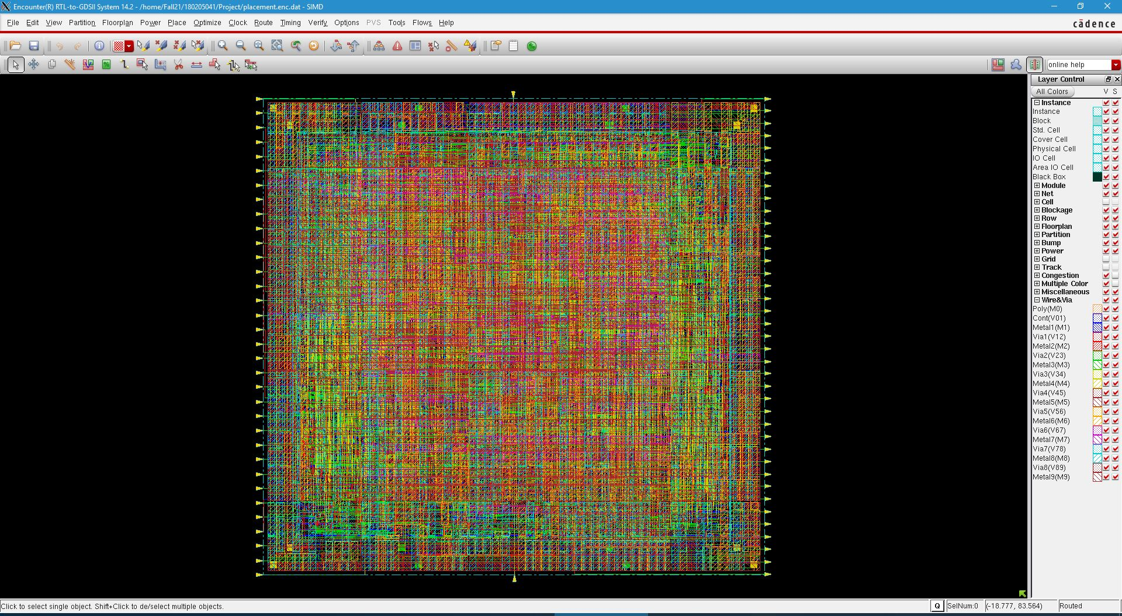
PNR
To fill any spaces between regular library cells, Filler cells are used. After adding filler cells and then re-route the design the final design will look like this:

Slide 13
Physical Verification
Name of verification | No. of violations
DRC | 5
Connectivity | 0
Geometry | 0
Antenna Rule Check | 0
PG short | 0
Power Via | 0
Stacked Via | 0
AC Limit | 0

Slide 14
CONCLUSION & FUTURE OUTCOMES
An SIMD processor can be fabricated through many ways. We tried to synthesis this IC by the use of cadence tools and verilog codes. Although the design was slower than a hard-wired design, the development time for an application using this IC will be significantly lower since designers can adopt a purely programming based model and need not be concerned with lower levels details such as data path design, control design, hardware patterns etc.
An SIMD processor can be applied to the RC4 key search problem and able to achieve a high level of parallelism as well as utilize the higher memory bandwidth available on the device. The SIMD approach also has benefits in that the design can be amortized over many different applications potentially resulting in a large overall savings in development effort. Finally, using this approach, there is potential to customize the instruction set of the processor as well as to add coprocessing elements to further accelerate application.

Slide 15

THANK YOU

Slide 16
REFERENCES
Y. Fujita, S. Kyo, N. Yamashita, and S. Okazaki. A 10 GIPS SIMD Processor for PC-based Real-Time Vision Applications Architecture, Algorithm Implementation and Lan- guage Support. In In Proceedings of the 4th International Workshop of the Computer Architecture for Machine Per- ception, (CAMP), pages 22–32, Washington, DC, USA, October 1997. IEEE Computer Society
H. Fatemi, H. Corporaal, T. Basten, R. Kleihorst, and P. Jonker. Designing Area and Performance Constrained SIMD/VLIW Image Processing Architectures. In Proceed- ings of Advanced Concepts for Intelligent Vision Systems (ACIVS), pages 689–696, Antwerp, Belgium, September2005. Springer-Verlag, Berlin, Germany, 2005. K. Elissa, “Title of paper if known,” unpublished.
https://github.com/zslwyuan/Basic-SIMD-Processor-Verilog-Tutorial

